Slide 1
Electronic Devices and Circuits Lecture-4
EEE 1231

Slide 2
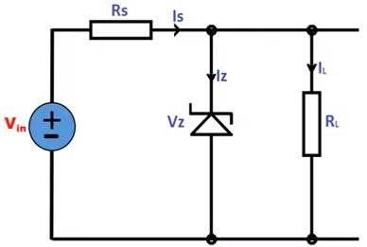
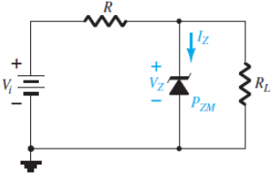
Regulated Power Supply Using Zener Diode
The process of keeping constant voltage across load regardless of variation of input voltage or load current is called regulation.
Zener diode is a specially designed diode which has ability to maintain constant voltage across load. Therefore zener diode can be used to provide constant voltage across load.
Due to increase in the source voltage if the voltage and current across the load increases. Then the load may be damaged due to over heating. To protect the load, zener diode is connected in parallel to the load R_{L}, in reverse fashion.
Prepared by Ipshita Tasnim Raha

Slide 3
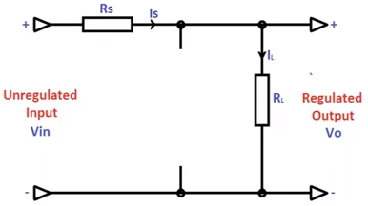
Regulated Power Supply Using Zener Diode
This circuit shows, zener diode as shunt voltage regulator. It’s called as shunt regulator because the zener diode is connected in parallel with the load resistor R_{L} in reverse fashion.
V_{in} is unregulated input voltage and V_{O} is regulated output voltage. Zener diode is reverse connected across the input voltage V_{in} whose variations are to be regulated.
The resistor R_{S} is used to limit the reverse current through the zener diode to safer value. The voltage source V_{in} and resistor R_{S} are so selected that the diode operates in breakdown region. The diode voltage in this region, is called as zener voltage V_{Z}, which is also voltage across R_{L} . Therefore V_{Z} = V_{O} , when zener voltage maintains constant voltage across the load
3
Prepared by Ipshita Tasnim Raha

Slide 4
Regulated Power Supply Using Zener Diode
The current through the diode is I_{z} (zener current) , current through series resistor is I_{s} (source current) and current through load resistor is I_{L} (load current) . As long as voltage across the load resistor R_{L} is less than zener voltage V_{Z}, diode does not conduct. In that case I_{S}=I_{L ,} because the zener diode is in open circuit condition.
When the supply voltage V_{in} increases and the voltage across the load resistor V_{O} becomes greater than or equal to zener breakdown voltage V_{Z ,} Zener diode starts conducting
By applying KCL at node 1 I_{S} = I_{Z} + I_{L}
Prepared by Ipshita Tasnim Raha

Slide 5
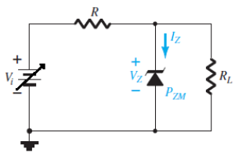
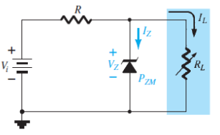
Line & Load Regulation
Basically there are two type of regulations such as:
Line Regulation: In this type of regulation, series resistance and load resistance are fixed, only input voltage is changing. Output voltage remains the same as long as the input voltage is maintained above a minimum value. The circuit diagram for line regulation is given,
Load Regulation: In this type of regulation, input voltage is fixed and the load resistance is varying. Output volt remains same, as long as the load resistance is maintained above a minimum value. The circuit diagram for load regulation is given,
Prepared by Ipshita Tasnim Raha

Slide 6
Diode Applications:
Clippers

Slide 7
Clipper Circuits
A clipper is a device that limits the positive amplitude or negative amplitude or both positive and negative amplitudes of the input AC signal. In some cases, a clipper removes a small portion of the positive half cycle or negative half cycle or both positive and negative half cycles.
The clipping (removal) of the input AC signal is done in such a way that the remaining part of the input AC signal will not be distorted.
Clippers are often referred to as voltage limiters, current limiters, slicers, or amplitude selectors. Clipper circuits are extensively used in digital computers, radars, television receivers, radio receivers and other electronic systems for removing unwanted portion of the input AC signal.
Prepared by Ipshita Tasnim Raha

Slide 8
Types of clippers
The clipper circuits are generally categorized into three types:
series clippers
shunt clippers
dual (combination) clippers
In series clippers, the diode is connected in series with the output load resistance. In shunt clippers, the diode is connected in parallel with the output load resistance.
Prepared by Ipshita Tasnim Raha

Slide 9
Types of clippers
The series clippers are again classified into four types:
series positive clipper
series positive clipper with bias
series negative clipper
series negative clipper with bias.
The shunt (parallel) clippers are again classified into four types:
shunt positive clipper
shunt positive clipper with bias
shunt negative clipper
shunt negative clipper with bias.
Dual (combination) clipper
Prepared by Ipshita Tasnim Raha

Slide 10
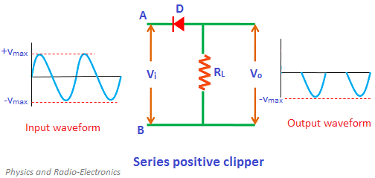
Series Positive Clipper
In the circuit diagram, the diode D is connected in series with the output load resistance R_{L} and the arrowhead of the diode is pointing towards the input. So the circuit is said to be a series positive clipper.
During the positive half cycle the diode is reverse biased. So the positive half cycle is blocked or removed at the output.
During the negative half cycle the diode is forward biased. So the negative half cycle is allowed at the output.
Thus, a series of positive half cycles are completely removed at the output.
Prepared by Ipshita Tasnim Raha

Slide 11
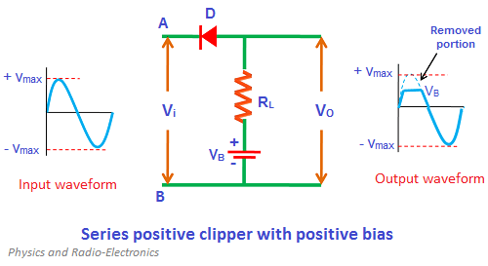
Series positive clipper with positive bias
During the positive half cycle the diode is reverse biased by the input supply voltage (V_{i}) and forward biased by the battery voltage (V_{B}).
Initially, the input supply voltage V_{i} is less than the battery voltage V_{B} (V_{i} < V_{B}). So the battery voltage dominates the input supply voltage. Hence, the diode is forward biased by the battery voltage and allows electric current through it. As a result, the signal appears at the output.
When the input supply voltage V_{i} becomes greater than the battery voltage V_{B}, the diode D is reverse biased. So no current flows through the diode. As a result, input signal does not appear at the output.
During the negative half cycle, it doesn’t matter whether the input supply voltage is greater or less than the battery voltage, the diode always remains forward biased. So the complete negative half cycle appears at the output.
Thus, the series positive clipper with positive bias removes a small portion of positive half cycles.
Prepared by Ipshita Tasnim Raha

Slide 12
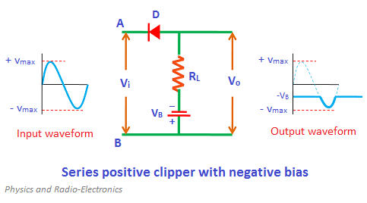
Series positive clipper with negative bias
During the positive half cycle, the diode D is reverse biased by both input supply voltage V_{i} and battery voltage V_{B}. So no signal appears at the output during the positive half cycle. Therefore, the complete positive half cycle is removed.
During the negative half cycle, the diode is forward biased by the input supply voltage V_{i} and reverse biased by the battery voltage V_{B}.
However, initially, the battery voltage V_{B} dominates the input supply voltage V_{i}. So the diode remains to be reverse biased until the V_{i} becomes greater than V_{B}.
When the input supply voltage V_{i} becomes greater than the battery voltage V_{B}, the diode is forward biased by the input supply voltage V_{i}. So the signal appears at the output.
Prepared by Ipshita Tasnim Raha

Slide 13
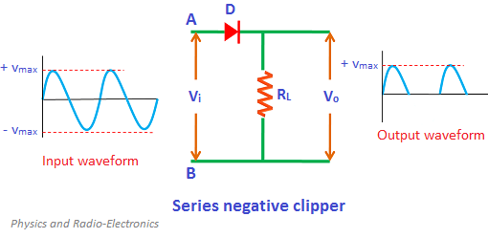
Series negative clipper
In series negative clipper, the negative half cycles of the input AC signal is removed at the output. The circuit construction of the series negative clipper is shown in the figure.
During the positive half cycle the diode D is forward biased during the positive half cycle. Therefore, a series of positive half cycles appears at the output
During the negative half cycle the diode D is reverse biased during the negative half cycle. So the negative half cycle is completely blocked or removed at the output. Thus, the series negative clipper removes the series of negative half cycles.
Prepared by Ipshita Tasnim Raha

Slide 14
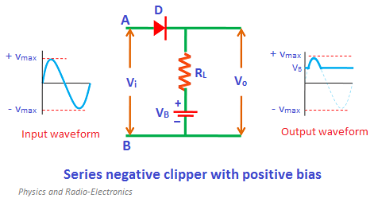
Series negative clipper with positive bias
During the positive half cycle the diode is reverse biased by the input supply voltage (V_{i}) and forward biased by the battery voltage (V_{B}). the diode is forward biased by input supply voltage V_{i} and reverse biased by battery voltage V_{B}.
Initially, the battery voltage is greater than the input supply voltage. Hence, the diode is reverse biased and does not allow electric current. Therefore, no signal appears at the output.
When the input supply voltage V_{i} becomes greater than the battery voltage V_{B}, the diode is forward biased and allows electric current. As a result, the signal appears at the output.
During the negative half cycle, the diode is reverse biased by both input supply voltage V_{i} and battery voltage V_{B}. So it doesn’t matter whether the input supply voltage is greater or less than the battery voltage V_{B}, the diode always remains reverse biased. Therefore, during the negative half cycle, no signal appears at the output.
Prepared by Ipshita Tasnim Raha

Slide 15
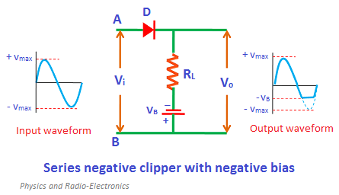
Series negative clipper with negative bias
During the positive half cycle the diode D is forward biased by both input supply voltage V_{i} and the battery voltage V_{B}. So it doesn’t matter whether the input supply voltage is greater or less than battery voltage V_{B}, the diode always remains forward biased. Therefore, during the positive half cycle, the signal appears at the output.
During the negative half cycle, the diode D is reverse biased by the input supply voltage V_{i} and forward biased by the battery voltage V_{B}.
Initially, the input supply voltage V_{i} is less than the battery voltage V_{B}. So the diode is forward biased by the battery voltage V_{B}. As a result, the signal appears at the output.
When the input supply voltage V_{i} becomes greater than the battery voltage V_{B}, the diode will become reverse biased. As a result, no signal appears at the output.
Prepared by Ipshita Tasnim Raha

Slide 16
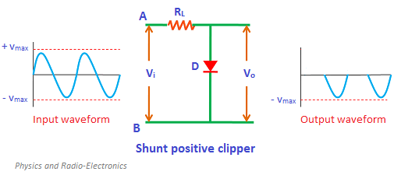
Shunt positive clipper
In shunt clipper, the diode is connected in parallel with the output load resistance. The operating principles of the shunt clipper are nearly opposite to the series clipper.
The series clipper passes the input signal to the output load when the diode is forward biased and blocks the input signal when the diode is reverse biased.
The shunt clipper on the other hand passes the input signal to the output load when the diode is reverse biased and blocks the input signal when the diode is forward biased.
In shunt positive clipper, during the
positive half cycle the diode is forward biased
And hence no output is generated. On the other
hand, during the negative half cycle the diode
is reverse biased and hence the entire negative
half cycle appears at the output.
Prepared by Ipshita Tasnim Raha

Slide 17
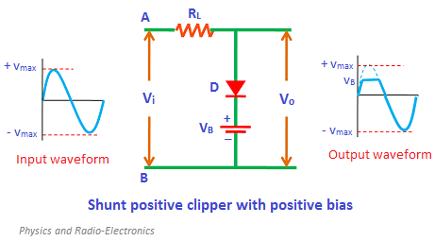
Shunt positive clipper with positive bias
During the positive half cycle , the diode is forward biased by the input supply voltage V_{i} and reverse biased by the battery voltage V_{B}.
However, initially, the input supply voltage V_{i} is less than the battery voltage V_{B}. Hence, the battery voltage V_{B} makes the diode to be reverse biased. Therefore, the signal appears at the output.
However, when the input supply voltage V_{i} becomes greater than the battery voltage V_{B}, the diode D is forward biased by the input supply voltage V_{i}. As a result, no signal appears at the output.
During the negative half cycle, the diode is reverse biased by both input supply voltage and battery voltage. So it doesn’t matter whether the input supply voltage is greater or lesser than the battery voltage, the diode always remains reverse biased. As a result, a complete negative half cycle appears at the output.
Prepared by Ipshita Tasnim Raha

Slide 18
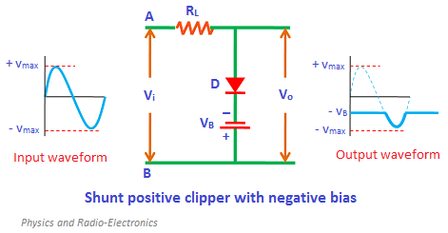
Shunt positive clipper with negative bias
During the positive half cycle, the diode is forward biased by both input supply voltage V_{i} and battery voltage V_{B}. Therefore, no signal appears at the output during the positive half cycle.
During the negative half cycle, the diode is reverse biased by the input supply voltage and forward biased by the battery voltage.
However, initially, the input supply voltage V_{i} is less than the battery voltage V_{B}. So the battery voltage makes the diode to be forward biased. As a result, no signal appears at the output.
However, when the input supply voltage V_{i} becomes greater than the battery voltage V_{B}, the diode is reverse biased by the input supply voltage V_{i}. As a result, the signal appears at the output.
Prepared by Ipshita Tasnim Raha

Slide 19
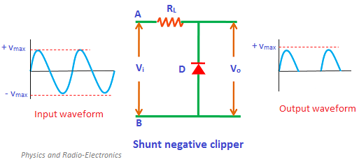
Shunt negative clipper
In shunt negative clipper, during the positive half cycle the diode is reverse biased and hence the entire positive half cycle appears at the output.
On the other hand, during the negative half cycle the diode is forward biased and hence no output signal is generated.
Prepared by Ipshita Tasnim Raha

Slide 20
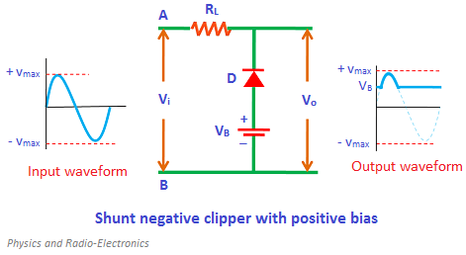
Shunt negative clipper with positive bias
During the positive half cycle, the diode is reverse biased by the input supply voltage V_{i} and forward biased by the battery voltage V_{B}.
However, initially, the input supply voltage is less than the battery voltage. So the diode is forward biased by the battery voltage. As a result, no signal appears at the output.
However, when the input supply voltage becomes greater than the battery voltage then the diode is reverse biased by the input supply voltage. As a result, the signal appears at the output.
During the negative half cycle, the diode is forward biased by both input supply voltage V_{i} and battery voltage V_{B}. So the complete negative half cycle is removed at the output.
Prepared by Ipshita Tasnim Raha

Slide 21
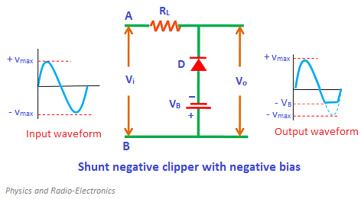
Shunt negative clipper with negative bias
During the positive half cycle, the diode is reverse biased by both input supply voltage V_{i} and battery voltage V_{B}. As a result, the complete positive half cycle appears at the output.
During the negative half cycle, the diode is forward biased by the input supply voltage V_{i} and reverse biased by the battery voltage V_{B}.
However, initially, the input supply voltage is less than the battery voltage. So the diode is reverse biased by the battery voltage. As a result, the signal appears at the output.
However, when the input supply voltage becomes greater than the battery voltage, the diode is forward biased by the input supply voltage. As a result, the signal does not appear at the output.
Prepared by Ipshita Tasnim Raha

Slide 22
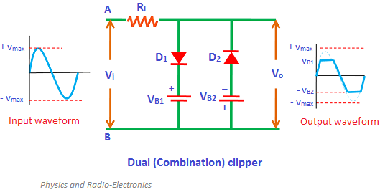
Dual (combination) clipper
The dual clippers are made by combining the biased shunt positive clipper and biased shunt negative clipper.
During the positive half cycle, the diode D₁ is forward biased by the input supply voltage V_{i} and reverse biased by the battery voltage V_{B1}. On the other hand, the diode D₂ is reverse biased by both input supply voltage V_{i} and battery voltage V_{B2.}
Initially, the input supply voltage is less than the battery voltage. So the diode D₁ is reverse biased by the battery voltage V_{B1}. Similarly, the diode D₂ is reverse biased by the battery voltage V_{B2}. As a result, the signal appears at the output. However, when the input supply voltage V_{i} becomes greater than the battery voltage V_{B1}, the diode D₁ is forward biased by the input supply voltage. As a result, no signal appears at the output
Prepared by Ipshita Tasnim Raha

Slide 23
Dual (combination) clipper
During the negative half cycle, the diode D₁ is reverse biased by both input supply voltage V_{i} and battery voltage V_{B1}. On the other hand, the diode D₂ is forward biased by the input supply voltage V_{i} and reverse biased by the battery voltage V_{B2}.
Initially, the battery voltage is greater than the input supply voltage. Therefore, the diode D₁ and diode D₂ are reverse biased by the battery voltage. As a result, the signal appears at the output.
When the input supply voltage becomes greater than the battery voltage V_{B2}, the diode D₂ is forward biased. As a result, no signal appears at the output.
Prepared by Ipshita Tasnim Raha

Slide 24
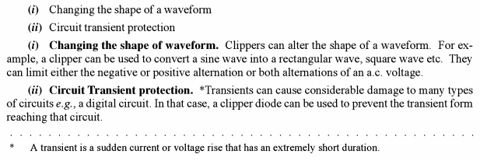
Applications of clippers
Prepared by Ipshita Tasnim Raha

Slide 25
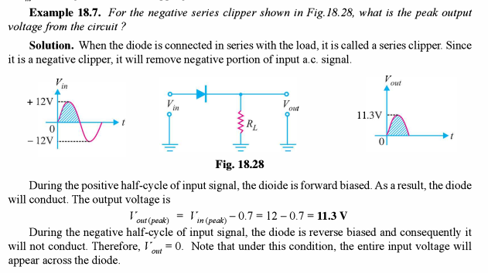
Math Problems on Clipping Circuits
Prepared by Ipshita Tasnim Raha

Slide 26
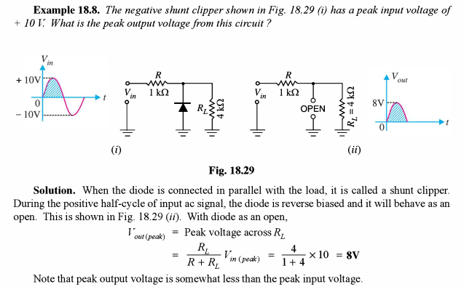
Math Problems on Clipping Circuits
Prepared by Ipshita Tasnim Raha

Slide 27
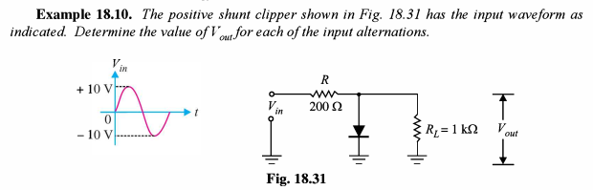
Math Problems on Clipping Circuits
Prepared by Ipshita Tasnim Raha

Slide 28
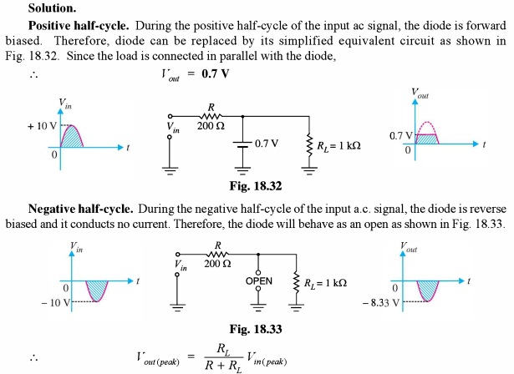

Math Problems on Clipping Circuits
Prepared by Ipshita Tasnim Raha

Slide 29
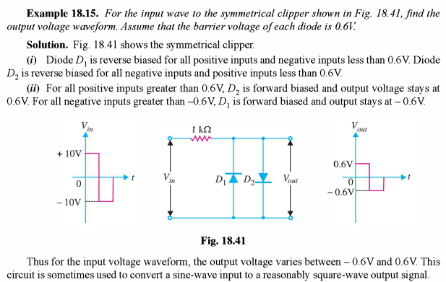
Math Problems on Clipping Circuits
Prepared by Ipshita Tasnim Raha

Slide 30
Diode Applications:
Clampers

Slide 31
Clamper circuits
A clamper is an electronic circuit that changes the DC level of a signal to the desired level without changing the shape of the applied signal. In other words, the clamper circuit moves the whole signal up or down to set either the positive peak or negative peak of the signal at the desired level.
The construction of the clamper circuit is almost similar to the clipper circuit. The only difference is the clamper circuit contains an extra element called capacitor. A capacitor is used to provide a dc offset (dc level) from the stored charge.
The basic difference between the clipper and clamper is that the clipper removes the unwanted portion of the input signal whereas the clamper moves the input signal upwards or downwards.
Clamper circuits are of three types:
Positive clampers
Negative clampers
Biased clampers
Prepared by Ipshita Tasnim Raha

Slide 32
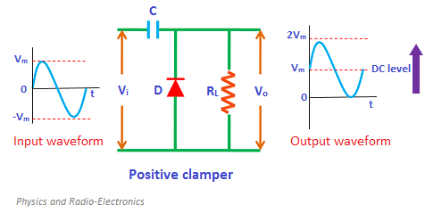
Positive clamper
The positive clamper is made up of a voltage source V_{i}, capacitor C, diode D, and load resistor R_{L}.
In the below circuit diagram, the diode is connected in parallel with the output load. So the positive clamper passes the input signal to the output load when the diode is reverse biased and blocks the input signal when the diode is forward biased.
Prepared by Ipshita Tasnim Raha

Slide 33
Positive clamper (+)ve half cycle
During the positive half cycle of the input AC signal, the diode is reverse biased and hence the signal appears at the output. In reverse biased condition, the diode does not allow electric current through it. So the input current directly flows towards the output.
When the positive half cycle begins, the diode is in the non-conducting state and the charge stored in the capacitor is discharged (released). Therefore, the voltage appeared at the output is equal to the sum of the voltage stored in the capacitor (V_{m}) and the input voltage (V_{m}) { I.e. Vo = V_{m}+ V_{m} = 2V_{m}} which have the same polarity with each other. As a result, the signal shifted upwards.
The peak to peak amplitude of the input signal is 2V_{m}, similarly the peak to peak amplitude of the output signal is also 2V_{m}. Therefore, the total swing of the output is same as the total swing of the input
Prepared by Ipshita Tasnim Raha

Slide 34
Positive clamper (-)ve half cycle
During the negative half cycle of the input AC signal, the diode is forward biased and hence no signal appears at the output.
In forward biased condition, the diode allows electric current through it. This current will flows to the capacitor and charges it to the peak value of input voltage Vm. The capacitor charged in inverse polarity (positive) with the input voltage. As input current or voltage decreases after attaining its maximum value -Vm, the capacitor holds the charge until the diode remains forward biased.
Prepared by Ipshita Tasnim Raha

Slide 35
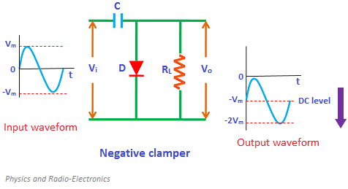
Negative clamper
During the positive half cycle of the input AC signal, the diode is forward biased and hence no signal appears at the output. In forward biased condition, the diode allows electric current through it. This current will flows to the capacitor and charges it to the peak value of input voltage in inverse polarity -Vm. As input current or voltage decreases after attaining its maximum value Vm, the capacitor holds the charge until the diode remains forward biased.
Prepared by Ipshita Tasnim Raha

Slide 36
Negative clamper
During the negative half cycle of the input AC signal, the diode is reverse biased and hence the signal appears at the output. In reverse biased condition, the diode does not allow electric current through it. So the input current directly flows towards the output.
When the negative half cycle begins, the diode is in the non-conducting state and the charge stored in the capacitor is discharged (released). Therefore, the voltage appeared at the output is equal to the sum of the voltage stored in the capacitor (-Vm) and the input voltage (-Vm) {I.e. Vo = -Vm- Vm = -2Vm} which have the same polarity with each other. As a result, the signal shifted downwards.
Prepared by Ipshita Tasnim Raha

Slide 37
Biased clampers
Sometimes an additional shift of DC level is needed. In such cases, biased clampers are used. The working principle of the biased clampers is almost similar to the unbiased clampers. The only difference is an extra element called DC battery is introduced in biased clampers.
Prepared by Ipshita Tasnim Raha

Slide 38
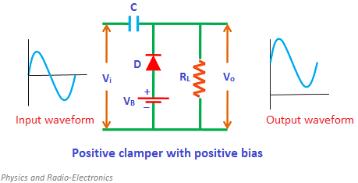
Positive clamper with positive bias
During the positive half cycle, the battery voltage forward biases the diode when the input supply voltage is less than the battery voltage. This current or voltage will flows to the capacitor and charges it. When the input supply voltage becomes greater than the battery voltage then the diode stops allowing electric current through it because the diode becomes reverse biased.
During the negative half cycle, the diode is forward biased by both input supply voltage and battery voltage. So the diode allows electric current. This current will flows to the capacitor and charges it.
Prepared by Ipshita Tasnim Raha

Slide 39
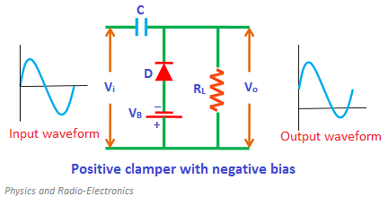
Positive clamper with negative bias
During the negative half cycle, the battery voltage reverse biases the diode when the input supply voltage is less than the battery voltage. As a result, the signal appears at the output. When the input supply voltage becomes greater than the battery voltage, the diode is forward biased by the input supply voltage and hence allows electric current through it. This current will flows to the capacitor and charges it.
During the positive half cycle, the diode is reverse biased by both input supply voltage and the battery voltage. As a result, the signal appears at the output. The signal appeared at the output is equal to the sum of the input voltage and capacitor voltage.
Prepared by Ipshita Tasnim Raha

Slide 40
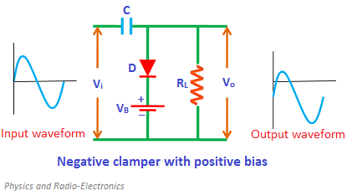
Negative clamper with positive bias
During the positive half cycle, the battery voltage reverse biases the diode when the input supply voltage is less than the battery voltage. When the input supply voltage becomes greater than the battery voltage, the diode is forward biased by the input supply voltage and hence allows electric current through it. This current will flows to the capacitor and charges it.
During the negative half cycle, the diode is reverse biased by both input supply voltage and battery voltage. As a result, the signal appears at the output.
Prepared by Ipshita Tasnim Raha

Slide 41
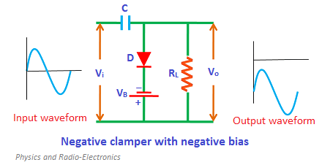
Negative clamper with negative bias
During the positive half cycle, the diode is forward biased by both input supply voltage and battery voltage. As a result, current flows through the capacitor and charges it.
During the negative half cycle, the battery voltage forward biases the diode when the input supply voltage is less than the battery voltage. When the input supply voltage becomes greater than the battery voltage, the diode is reverse-biased by the input supply voltage and hence signal appears at the output.
Prepared by Ipshita Tasnim Raha

Slide 42
Clamper circuit operation (Book reference)
Principles of electronics by V.K. Mehta
18.20: clamping Circuits | Page-495
18.21: Basic Idea of a Clamper | Page-496
18.22: Positive Clamper | Page-496
18.23: Negative Clamper | Page-497
Math reference | 18.19, 18.20, 18.21, 18.22.

Slide 43
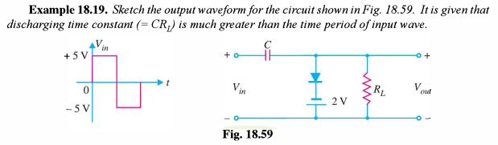
Math Problems on Clamper Circuits
Prepared by Ipshita Tasnim Raha

Slide 44
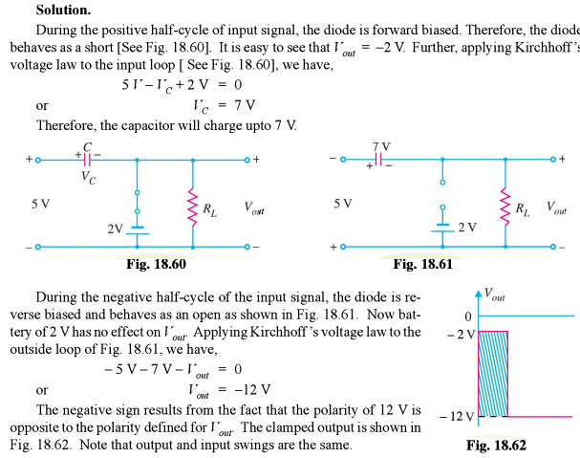
Math Problems on Clamper Circuits
Prepared by Ipshita Tasnim Raha

Slide 45
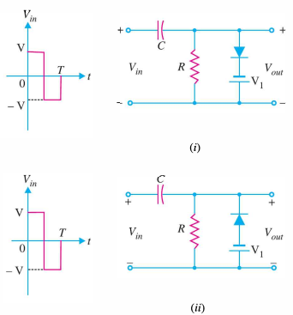
Home Task
Prepared by Ipshita Tasnim Raha

Slide 46
Education is learning
what you didn’t even know
you didn’t know
- Daniel J.Boorstin
Prepared by Ipshita Tasnim Raha

Slide 47
Thanks!
Any questions?

